Slide 1
The Modern Software Developer
CS146S
Stanford University, Fall 2026
Mihail Eric
themodernsoftware.dev

Slide 2
Logistics
Factory workshop
  Thursday, 6:20-645pm
Announcing the OSS partners program
  Anyscale (Ray)
  Arize AI (Phoenix)
  Browserbase
  cmux
  CopilotKit
  CrewAI
  HeyGen
  Marimo
  OpenHands
  Pi
  Unsloth AI
  Vercel
  Warp
  Zilliz
themodernsoftware.dev

Slide 3
Advanced Prompting and Context Engineering for Complex Codebases
themodernsoftware.dev
Notes:
Which brings us to this course…

Slide 4
Orientation
Objective
  Move beyond ad-hoc prompting to a robust and reliable synchronous AI development workflow
  Use AI to rapidly onboard to unfamiliar codebases and systematically complete complex coding tasks
Lesson Plan
  Learn how to onboard to large unfamiliar codebases rapidly
  Learn spec-driven engineering via the RePPIT framework
    Research
    Propose
    Plan
    Implement
    Test
  Learn about other spec-driven AI development frameworks
themodernsoftware.dev

Slide 5
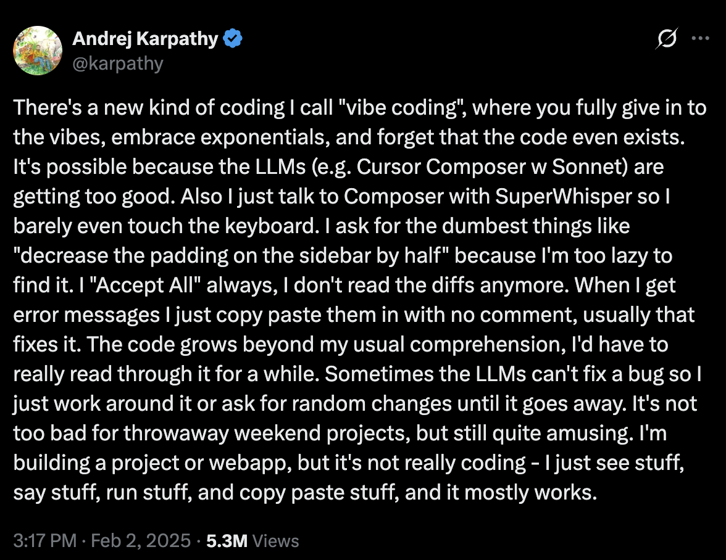
themodernsoftware.dev

Slide 6
Vibe coding confuses expectations
themodernsoftware.dev
Notes:
Vibe coding has different definitions but the standard one of just YOLO-ing and tab-accepting AI code is not the focus here

Slide 7
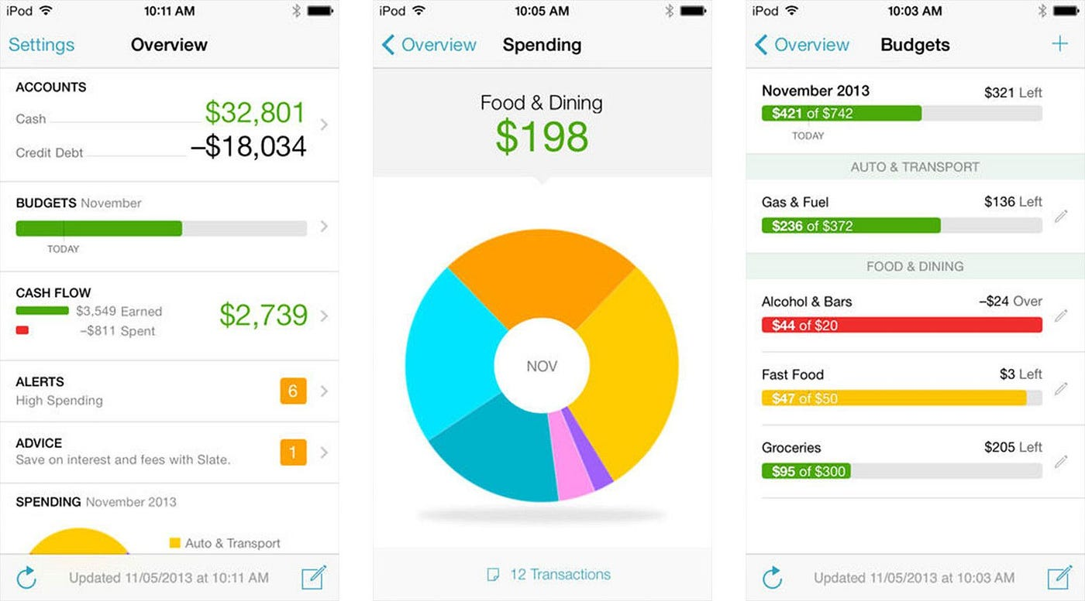
How would you build a Mint clone?
themodernsoftware.dev

Slide 8
Writing production AI code requires being methodical
themodernsoftware.dev
Notes:
You should have an active, functional mental model of how you would build your solution

Slide 9
Principles of Production AI Code
Understand an unfamiliar codebase
Propose some solutions
Plan out the most promising solution
Implement it
Test it
themodernsoftware.dev
Notes:
These days bad code is both architecturally wrong decisions but also functionally incorrect software (from hallucinating LLMs)

Slide 10
Use RePPIT
themodernsoftware.dev

Slide 11
R esearch
P ropose
P lan
I mplement
T est
themodernsoftware.dev
Notes:
This is something you should iterate on to find what works for you but these high level points should be a solid starting point for your own workflow

Slide 12
Demo
Feature: Include a trend line showing spending by category over time.
themodernsoftware.dev

Slide 13
System prompt
AGENTS.md/CLAUDE.md
½-¾ of “smart” tokens
in context window
Task-specific context
the “dumb” zone
themodernsoftware.dev

Slide 14
Best practices
Review your specs very carefully
For very large features, break your task down into task lists
  When an item is finished, document your agent’s work in a written artifact
  This becomes context with which the next item can be continued
Be very mindful of your context window (½-¾ of “smart” tokens)
themodernsoftware.dev

Slide 15
Task delegation taxonomy
Approaches
  Simple prompting
  Make a plan
  Research then plan
  (Research then plan) x N
When to apply each?
themodernsoftware.dev

Slide 16
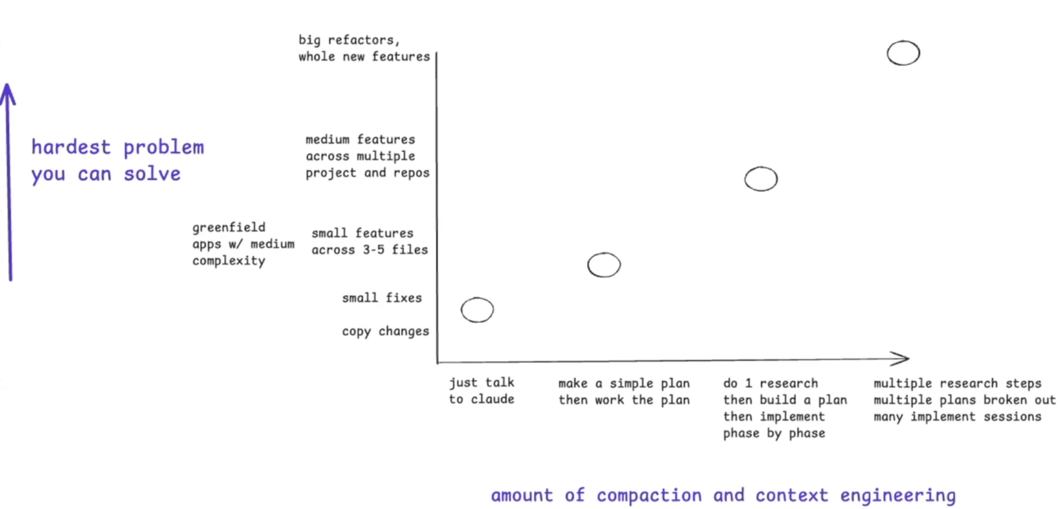
Task delegation taxonomy
Source
themodernsoftware.dev

Slide 17
Other popular frameworks
Superpowers
  Opinionated end-to-end, guided workflow for solving complex tasks
  TDD-based
  A set of agent skills that can be used for spec/plan creation, implementation, and testing
  Built-in parallelism
Openspec
  Lightweight flow for developing specs, implementation plans, etc
  Neat methodology around tracking changes in source-of-truth specs and merging them after a diff is made
themodernsoftware.dev

Slide 18
Spec management
Where do specs live?
  Linear or locally/Git (as per OpenSpec)
Design tradeoffs / decision points for parts of the codebase can live in .notes/
themodernsoftware.dev

